Slide 1
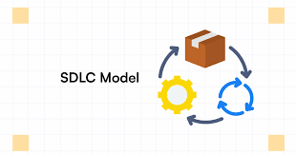
Done by:
Chandrasekaran R
Janani K
Mukesh B

Slide 2
AGENDA
Waterfall Model
Iterative Model
Spiral Model
V Model
DevOps Model
Agile Model

Slide 3
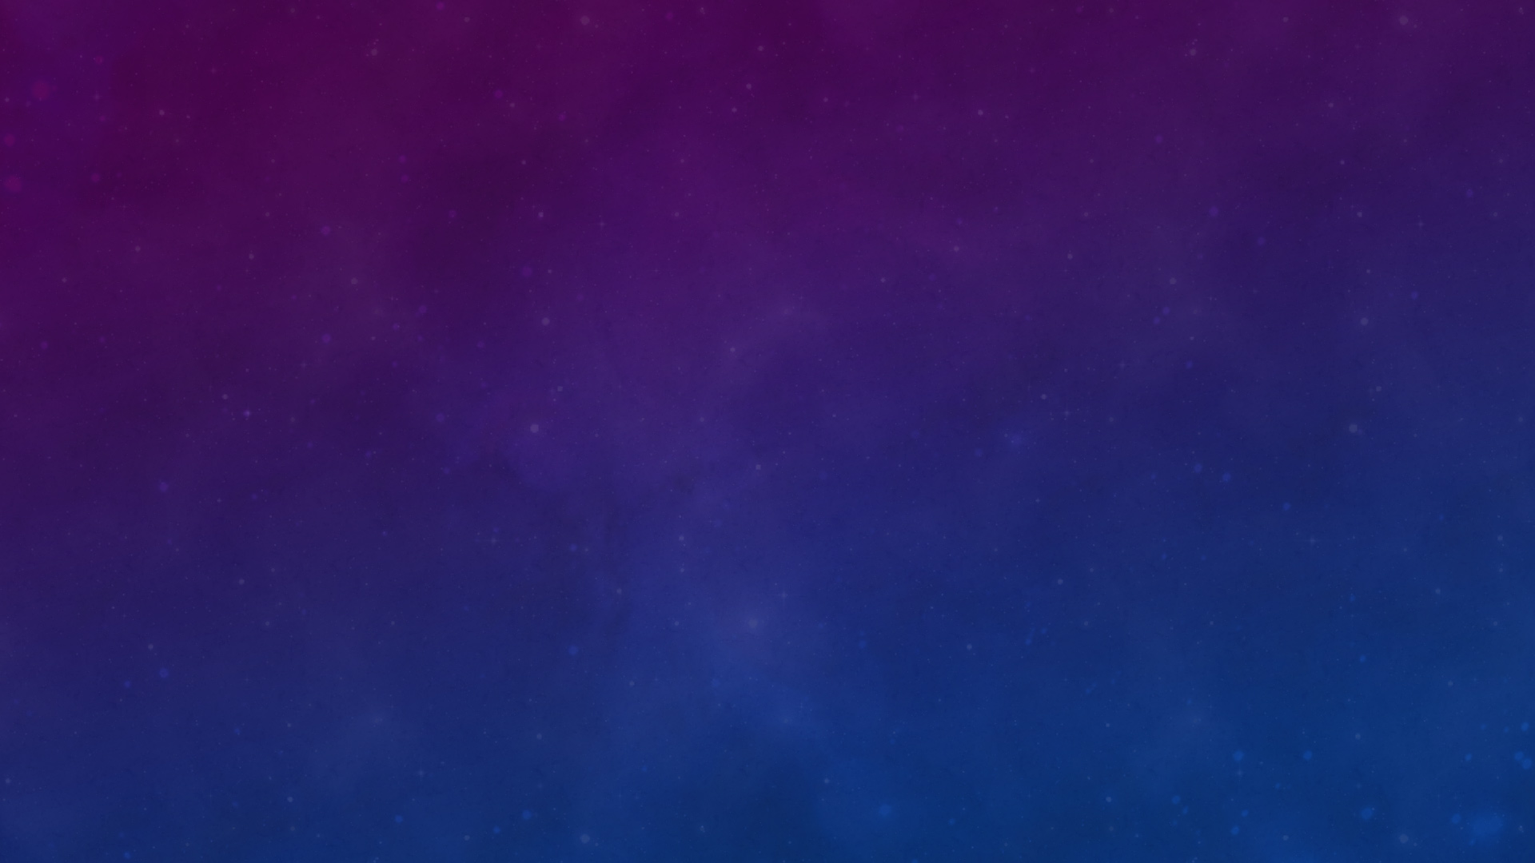
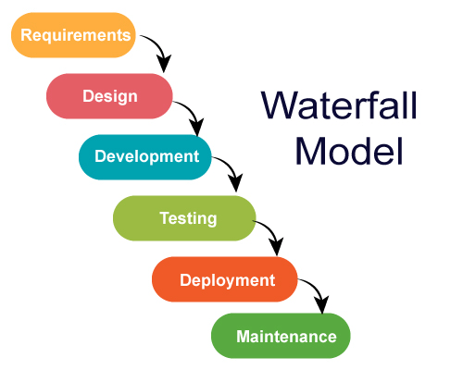
WATERFALL MODEL
(SMALL TO MEDIUM)
The Waterfall model is a traditional, linear and sequential approach to software development and project management, where each phase must be completed before moving on to the next.
What: The Waterfall model consists of distinct, sequential phases (Fig 1.1)
When: Waterfall is ideal for projects where:
- Requirements are clear and stable from the start.
- Changes are minimal during development.
- A structured, predictable approach is needed, especially for smaller projects.
Why: Advantages of Waterfall include:
- Clear structure with defined deliverables at each phase.
- Upfront planning ensures a solid understanding of the scope.
- Minimal rework due to stable requirements.
- Extensive documentation provides a clear record of decisions.
Fig 1.1

Slide 4
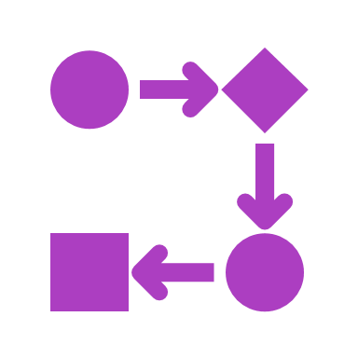
How: The process involves:
1. Requirement Gathering: All project requirements are documented.
2. System Design: Architecture and technical specifications are created.
3. Implementation: Developers begin coding.
4. Testing: The system is thoroughly tested.
5. Deployment: The final product is deployed.
6. Maintenance: Post-launch fixes and updates are made.
Real-Time Examples:
- Software Development: A banking application with fixed features (account management, transactions, etc.) is built and tested before deployment.

Slide 5
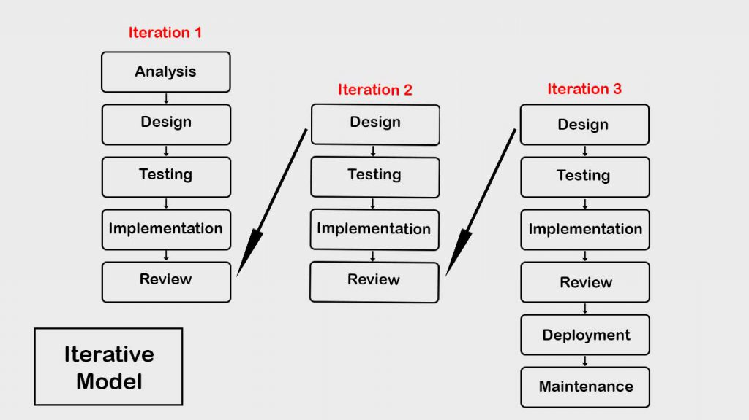
2. iterative-model (small, medium, large )
The Iterative Model in SDLC offers a flexible, adaptive approach to software development, which makes it particularly valuable for projects with evolving requirements, high complexity, or the need for continuous feedback.
Features:
Incremental delivery
Early testing
Flexibility make the iterative model ideal for projects that require constant refinement based on user feedback.
Fig 2.1​

Slide 6
Benefits:
Early delivery of working software
Improved quality
Reduced risks
Better stakeholder satisfaction due to continuous involvement.
Example: Video Game Development(subsequent iterations, more levels, graphics, and features are added based on player feedback), Web Development(Subsequent iterations add more features).

Slide 7
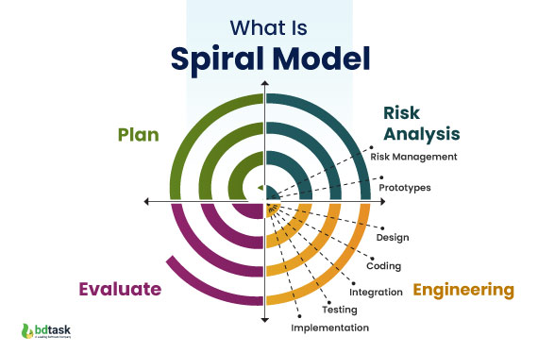
3. spiral model (large )
The Spiral Model is an iterative, risk-driven software development process combining Waterfall and Prototyping, introduced by Barry Boehm in 1986. It emphasizes risk management and continuous refinement through repeated cycles or spirals.
Key Features
Cyclical Development: Repeated iterations with four phases:
Planning: Define goals and requirements.
Risk Analysis: Identify and assess risks.
Engineering: Incremental development and refinement.
Evaluation: Review progress and gather feedback.
Risk Management: Focuses on early risk identification and mitigation.
Iterative Improvement: Each cycle produces a prototype for refinement.
Fig 3.1​

Slide 8
When to Use
Large, Complex Projects with evolving requirements.
High-Risk Projects requiring ongoing risk management.
Projects with Flexible Requirements needing frequent adjustments.
Benefits
Early Risk Mitigation through continuous assessment.
Frequent Prototyping allows for regular feedback and refinement.
Stakeholder Involvement ensures engagement throughout development.
Adaptability to handle evolving requirements.
Real-World Examples
Software Development: Large systems like e-commerce platforms with evolving needs.
Embedded Systems: Hardware-dependent systems like vehicle systems requiring constant testing and adaptation.
Conclusion
The Spiral Model is ideal for complex, high-risk projects requiring frequent risk analysis, iterative development, and stakeholder feedback. It is well-suited for environments with evolving requirements and the need for constant refinement.

Slide 9
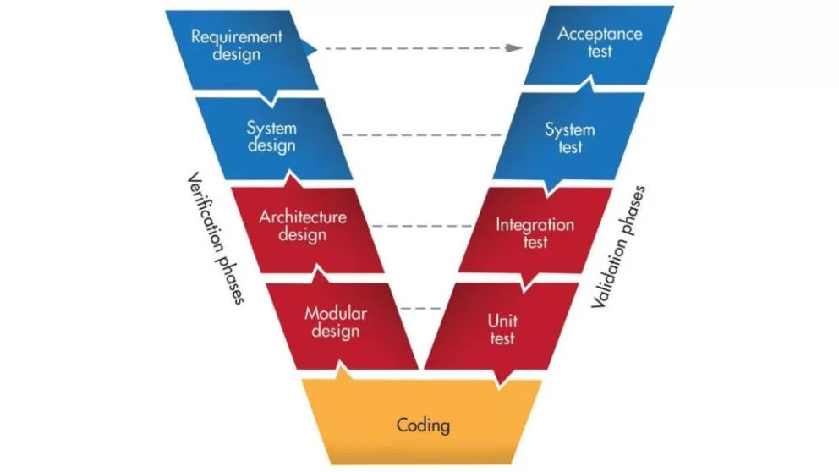
4. v-model (sMALL, medium, large )
The V-Model is a software development approach that extends the Waterfall model by integrating verification and validation activities with each phase of development. It follows a sequential structure where each development phase (such as requirements analysis, design, and coding) has a corresponding testing phase (unit testing, integration testing, system testing).
Fig 4.1

Slide 10
When to Use:
Ideal for projects with well-defined requirements and minimal changes.
Suitable for industries like healthcare or aerospace, where safety and regulatory compliance are crucial.
Example:
A mobile banking app undergoes detailed unit testing, integration testing, and system testing to ensure all features (e.g., transactions, security) work as expected.
Benefits:
Early testing catches defects early.
Clear traceability between development and testing.
High quality assurance throughout the process.

Slide 11
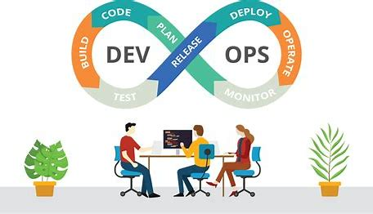
5. DevOps-model (small, medium, large )
The DevOps SDLC is a modern approach that integrates development (Dev) and IT operations (Ops) to improve the efficiency, quality, and speed of software delivery.
Core Principles:
Automation
Collaboration
Continuous
Feedback
Benefits:
Faster time to market
Improved software quality
Better collaboration between teams
Scalability and flexibility
Enhanced security
Fig 5.1​
It is particularly suitable for projects where fast iteration, frequent updates, and automated workflows are essential.

Slide 12
DevOps Tools Used in SDLC
To implement DevOps successfully, several tools are commonly used to automate various processes:
CI/CD Tools: Jenkins, GitLab CI, Travis CI, CircleCI
Version Control: Git, GitHub, Bitbucket
Configuration Management: Ansible, Puppet, Chef
Containerization and Orchestration: Docker, Kubernetes
Monitoring and Logging: Prometheus, Nagios, ELK Stack (Elasticsearch, Logstash, Kibana)
Cloud Platforms: AWS, Azure, Google Cloud Platform (GCP)
Collaboration Tools: Slack, Microsoft Teams, Jira, Confluence
Example: E-commerce Platform (eg: Amazon, eBay)

Slide 13
6. Agile model (Medium to large)
Non – Agile Methodology | Agile Methodology
A project can take several months or years to complete and the customer may not get to see the end product unitl the completion of the project. | It have sprints or iterations which are shorter in duration (Sprints/Iterations can vary from 2 weeks to 2 months) during which pre-determined features are developed and delivered.
Allocate extensive periods of time for Requirements gathering, design, development, testing and User Acceptance Testing, before finally deploying the project.
Process for developing software
Agile means
*Ability to move quickly
*Responding swiftly to change

Slide 14
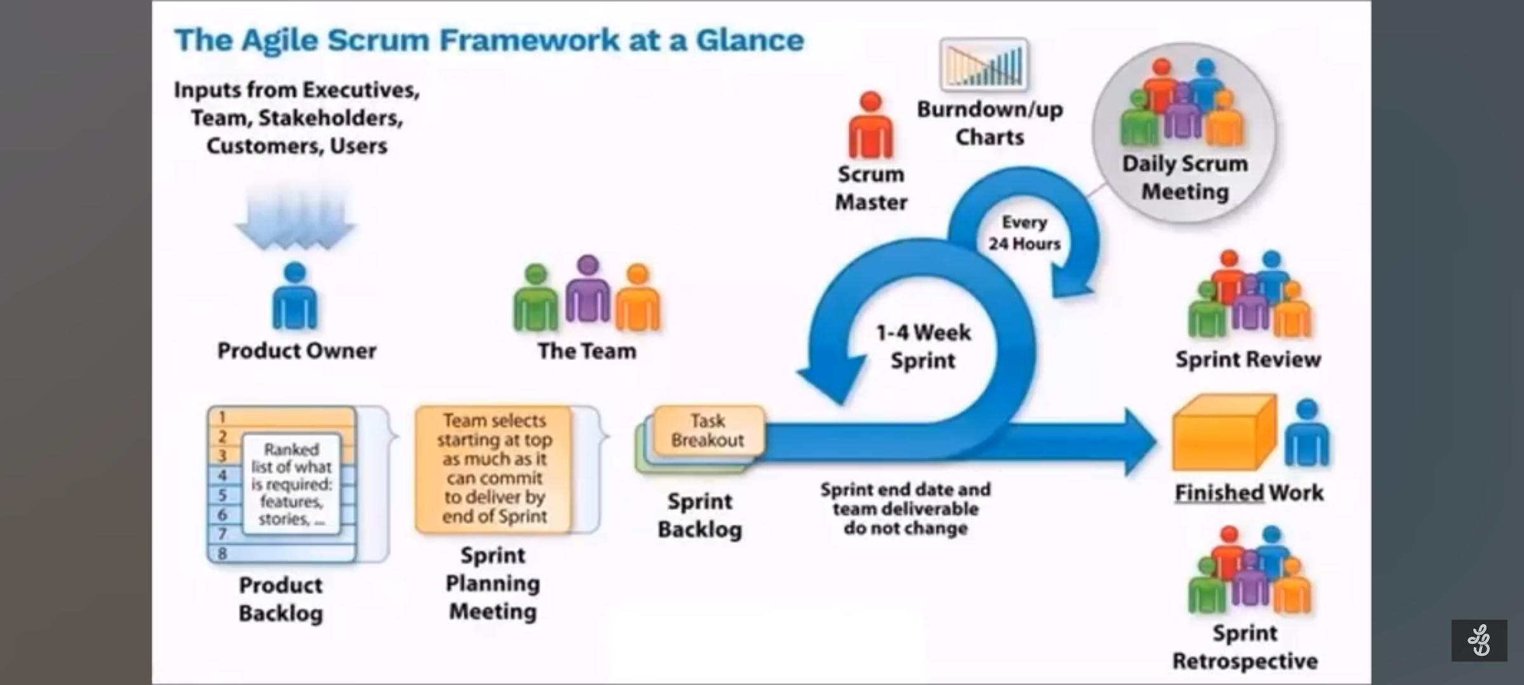
SCRUM
Framework for managing work with an emphasis on software development.
Software development -> Iterations (within time-boxed)
Scrum key Roles
Scrum master
Scrum product Owner
Development Team

Slide 15
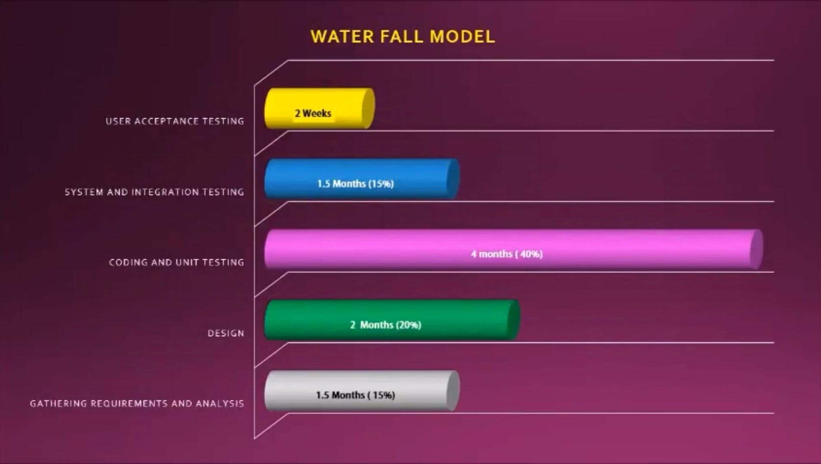
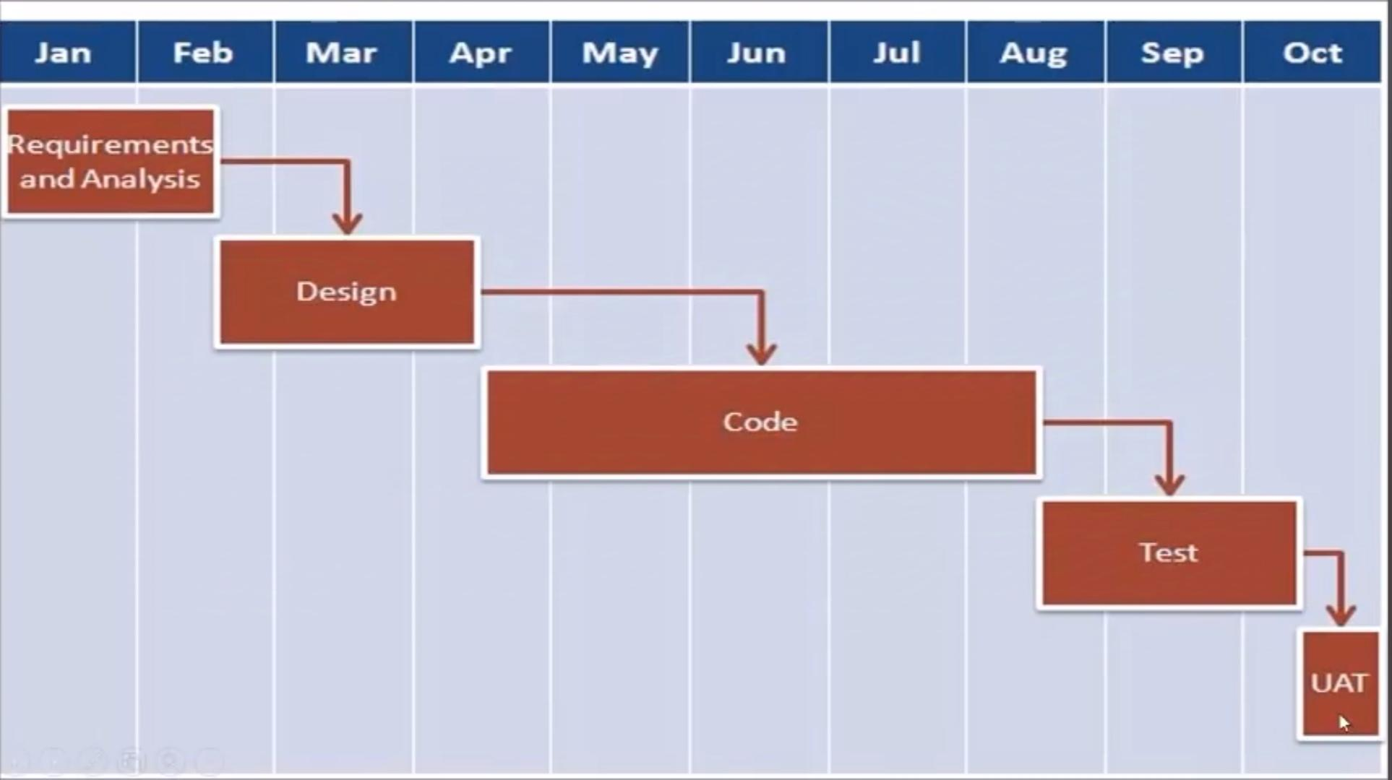
Example of Agile software development
Product – MS word
Features – All the features provided by MS word and any other features requested by the marketing team.

Slide 16

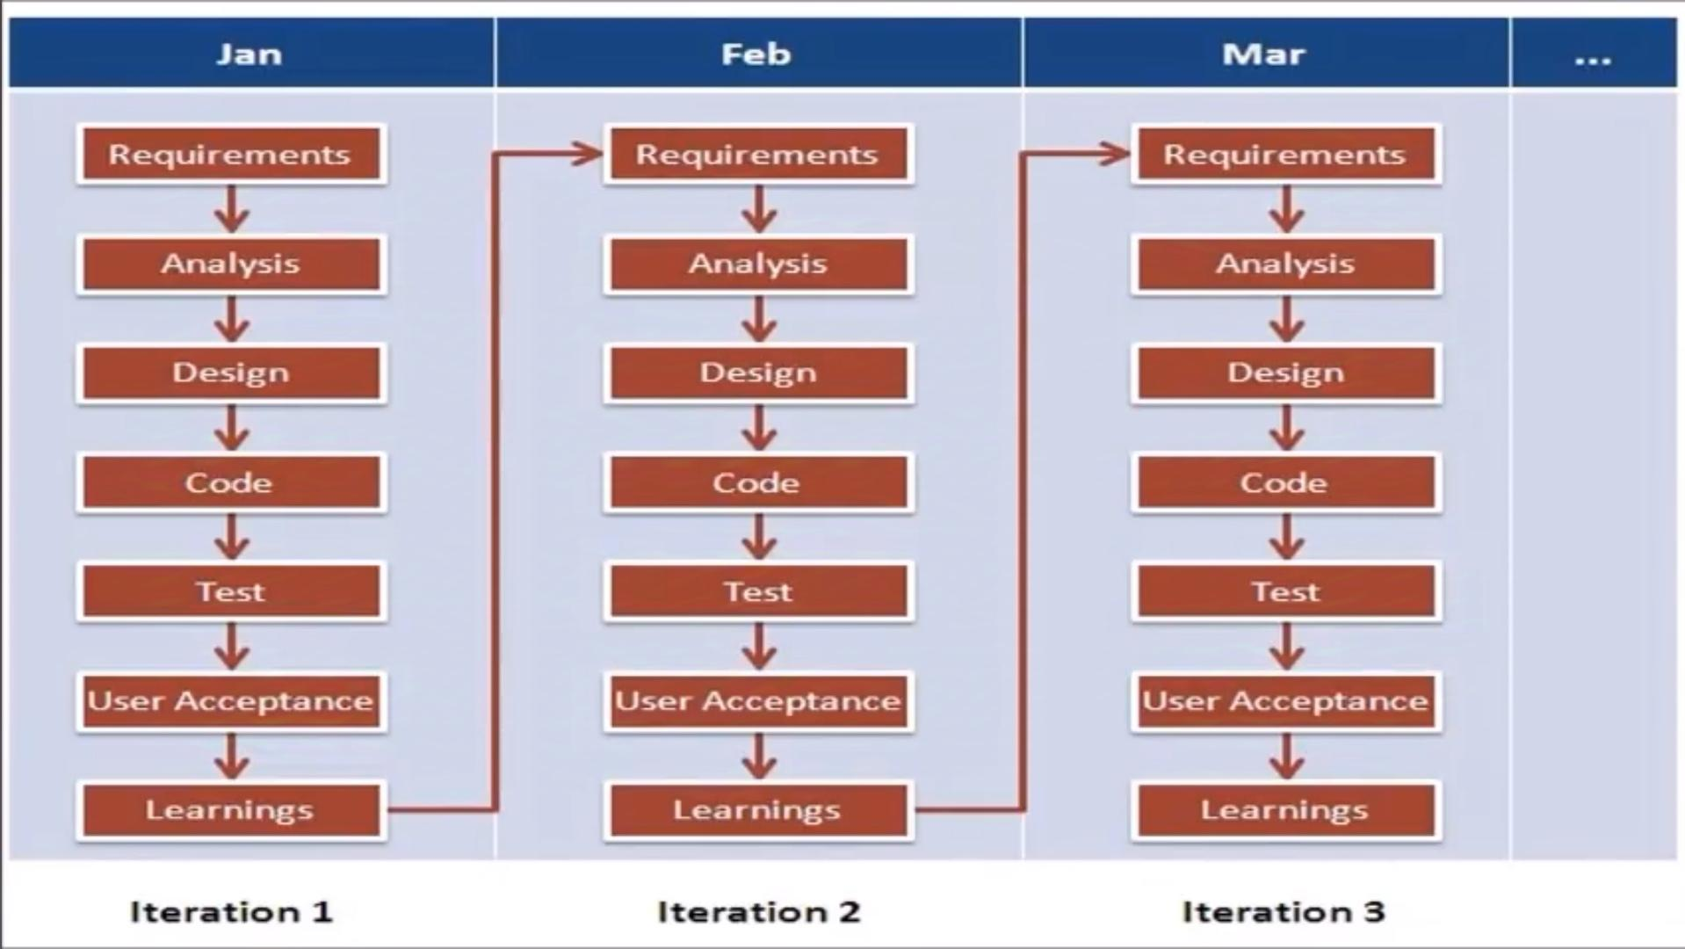
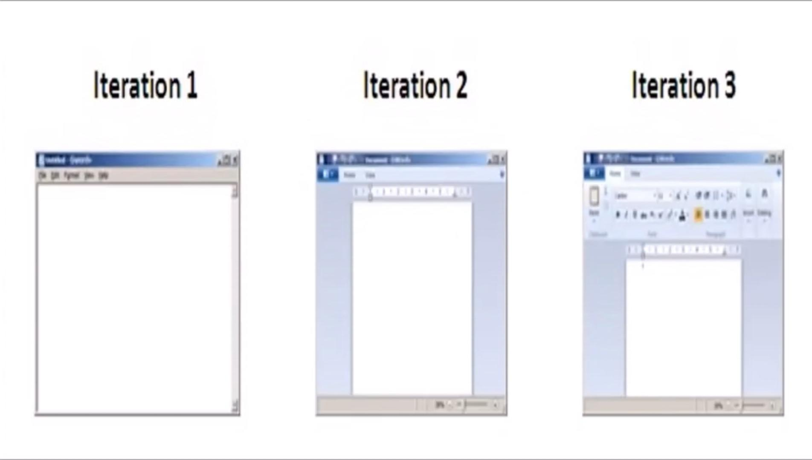
Using Agile Methodology

Slide 17
Advantages | Disadvantages
The delivery of software is unremitting. | The documentation is less.
The customers are satisfied because after every sprint working feature of the software is delivered to them. | Sometimes, the requirement is not very clear hence it's difficult to predict the expected result.
If the customer has any feedback or any change in the feature then it can be accommodated in the current release of the product. | In few of the projects at the starting of the software development life cycle it's difficult to estimate the actual effort required.
The daily interactions are required between the business people and the developers. Attention is paid to the good design of the product. | The projects may have to face some unknown risks which can affect the development of the project.

Slide 18


